Slide 1
Project: M1 Apple Laptop Purchase Prediction
WISDOM IZUCHUKWU ADIKE

Slide 2
TABLE OF CONTENTS
01
04
02
05
03
Dataset Description
Analysis and findings
Describing the dataset and outlining useful info.
Machine learning analysis and findings.
Objectives
Advanced steps
Main obective of the analysis.
Models flaws and advanced steps.
Building Models
Applying various Classification models.

Slide 3
DATASET Description

Slide 4
INTRODUCTION
The Apple M1 MacBook is a popular laptop that has gained a lot of attention in recent years due to its impressive performance and energy efficiency. If you are considering purchasing an M1 MacBook, there are several factors that you may want to consider before making your decision. One factor to consider is your budget. The M1 MacBook is available in a range of prices, depending on the specific model and configuration you choose. It's important to carefully consider your budget and choose a model that fits your needs and your financial situation. Another factor to consider is your computing needs.
The M1 MacBook is a powerful machine that is well-suited for a wide range of tasks, including running demanding software, playing games, and handling heavy workloads. However, if you only need a laptop for basic tasks like web browsing and word processing, you may be able to get by with a less powerful and less expensive model. You may also want to consider the design and form factor of the M1 MacBook. The M1 MacBook is available in both 13-inch and 16-inch sizes, and you'll need to decide which size is right for you. Additionally, the M1 MacBook is available in both a standard laptop form factor and a more portable "MacBook Air" form factor.
Finally, you'll want to consider the availability and support options for the M1 MacBook. Apple is known for its strong support network, and the M1 MacBook is no exception. You can find support through Apple's online resources, as well as through authorized Apple service providers.

Slide 5
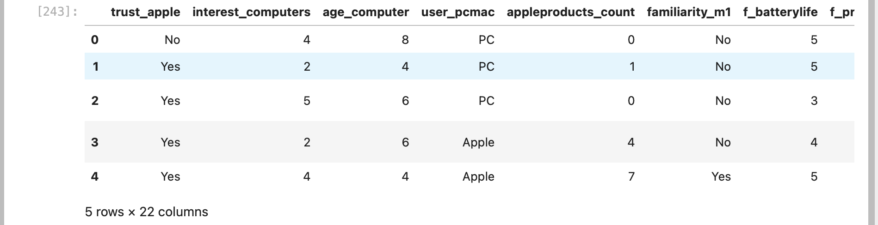
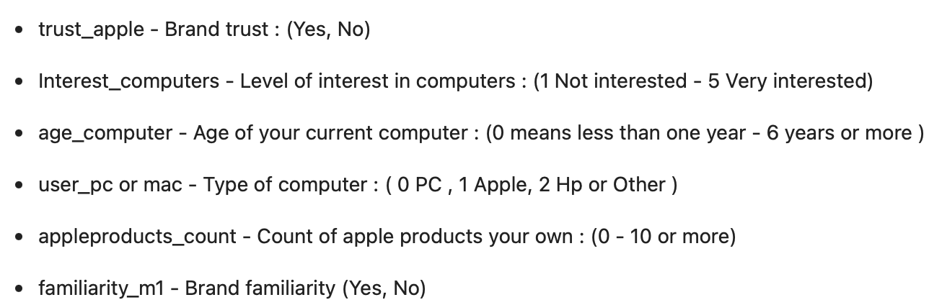
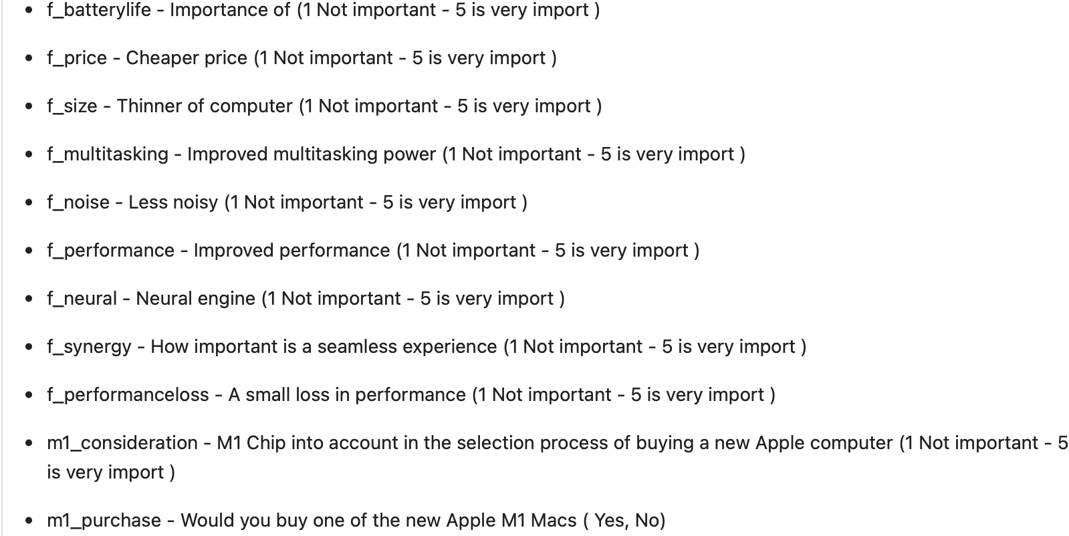
DATASET DESCRIPTION 01

Slide 6
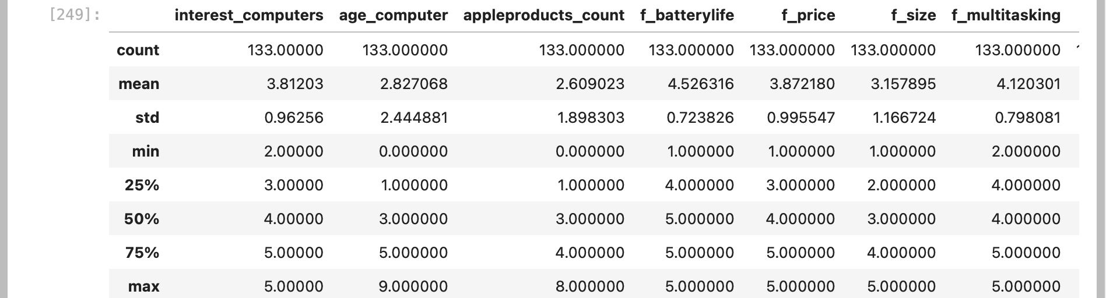
DATASET DESCRIPTION 02

Slide 7
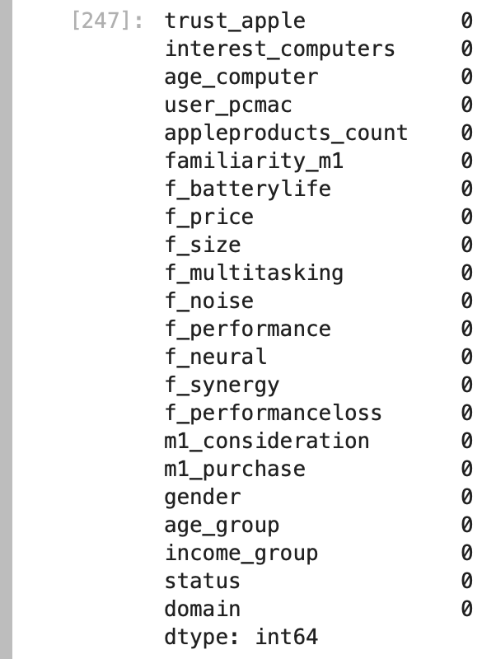
DATASET DESCRIPTION 03
After data cleaning, we can see we have no missing value.

Slide 8
DATA Analysis

Slide 9

Objective of the analysis
In this section, I am demonstrating the connection between various characteristics to identify the features that have the most significant impact on our target variable, 'm1_purchase.' Following that, I am constructing various classification models utilizing advanced methods like GridSearch, ML pipelines, and fine-tuning hyperparameters to attain the optimal predictive model in terms of accuracy. Furthermore, I will address the weaknesses of each model.

Slide 10
DATA ANALYSIS 01
After data processing, we identified the categorical and continuous features so we can know their relationships.

Slide 11
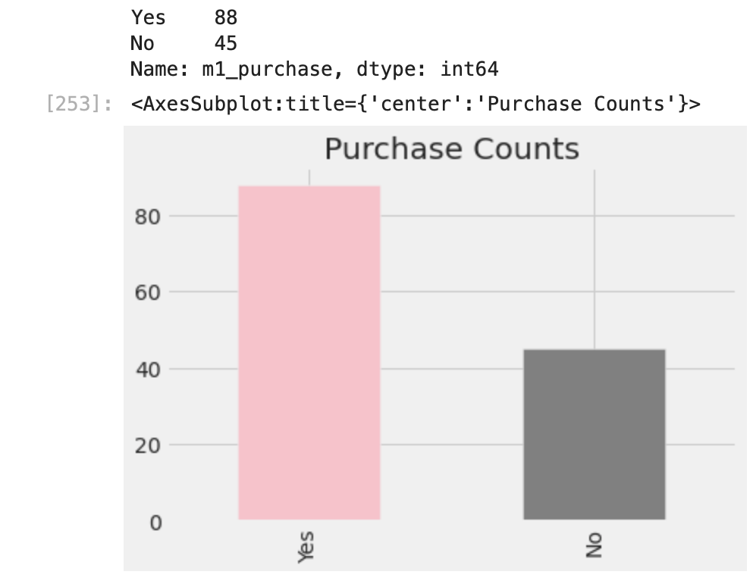
DATA ANALYSIS 02
From the chart, we have 88 purchases of the M1 Apple Laptop and 45 no purchase.

Slide 12
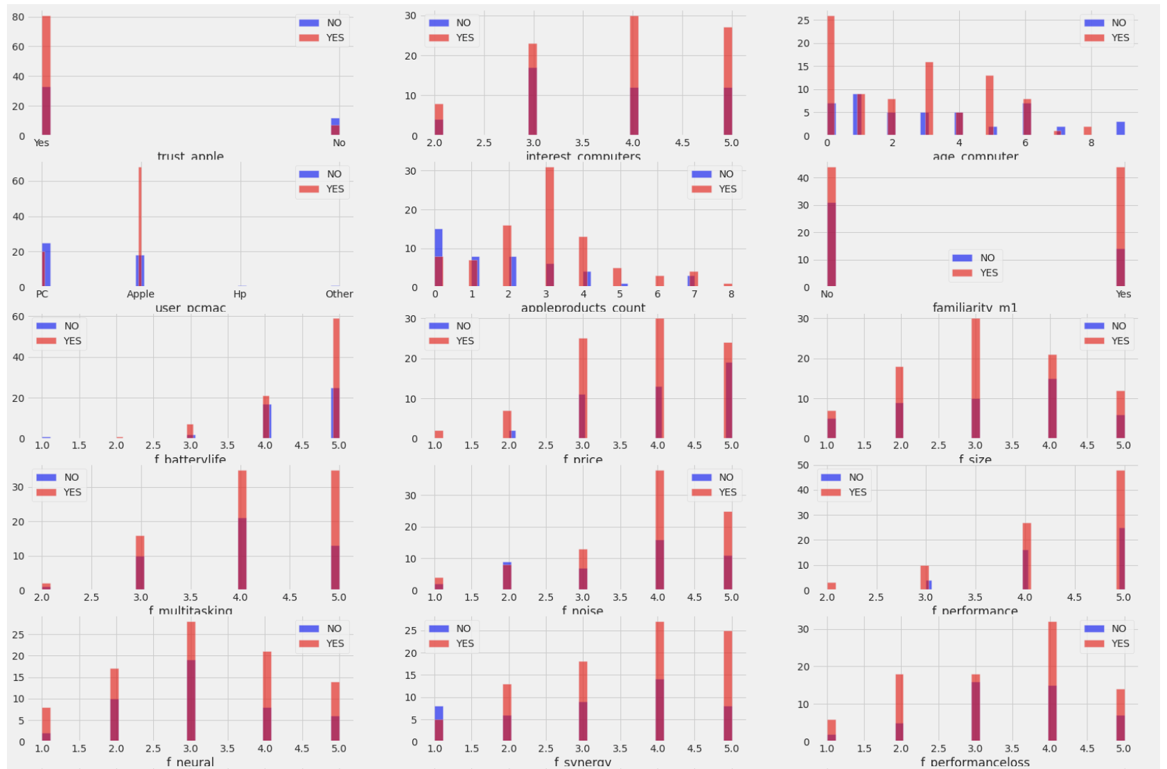
DATA ANALYSIS 03
Study of the relationship of categorical features and the m1_purchase:
trust_apple: Looking at the chart, we can see based on the brand trust, people who tends to trust the Apple brand have more tendency to purchase the M1 Apple Laptop.
age_computer: On the chart, 0 means the computer is less than 1 year old and we have more of it which influences the purchase outcome, followed by 3 years old computers.
f_performance: The performance of the M1 Apple Laptop product greatly influenced the purchase outcome. On the chart, 5 means its a high performance product. Having more of 5 on the bar chart convinces people to purchase more of the high performance M1 Laptop.

Slide 13
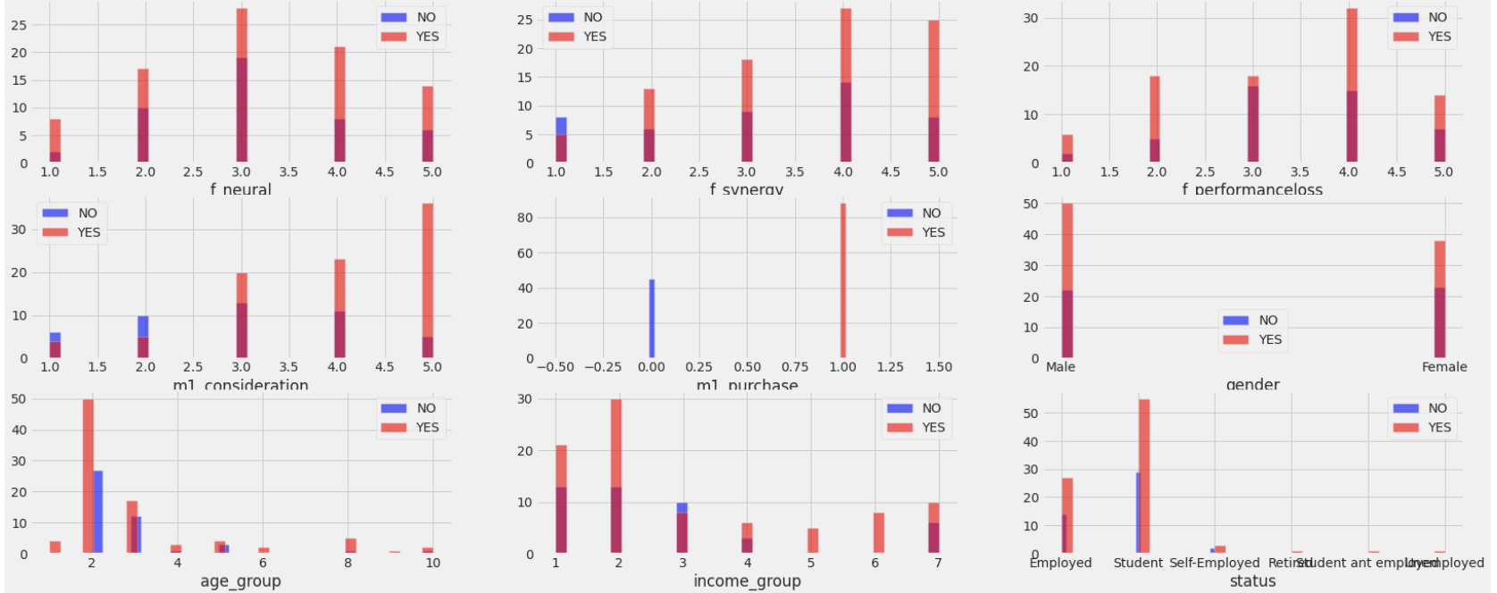
DATA ANALYSIS 04
Study of the relationship of categorical features and the m1_purchase:
f_synergy: Looking at the chart, we can see based on the importance of the seamless experience, the M1 Laptop has more of value 4 which shows the product can be used without hassle and that influences the purchase outcome
f_neural: On the chart, 5 means the computer has an important neaural engine which influences the purchase outcome, we can notice value 3 is more, followed by 4 and it’s one of the reason it got more purchases.
gender: What do we say here? Gender might also influence the purchasing outcome. On the chart, males are more in possession of the M1 laptop than females. This can be an issue for the ladies who are more into girly things.

Slide 14
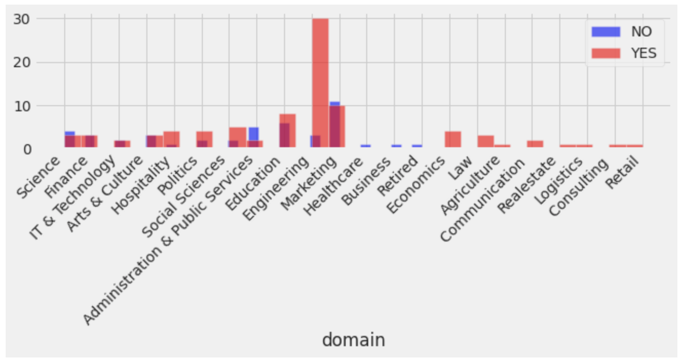
DATA ANALYSIS 05
As clearly seen in our bar chart, the M1 Laptop is more used in the Engineering sector and it also influences the purchase outcome in the case where Engineers tends to buy more which is followed by the marketers.

Slide 15
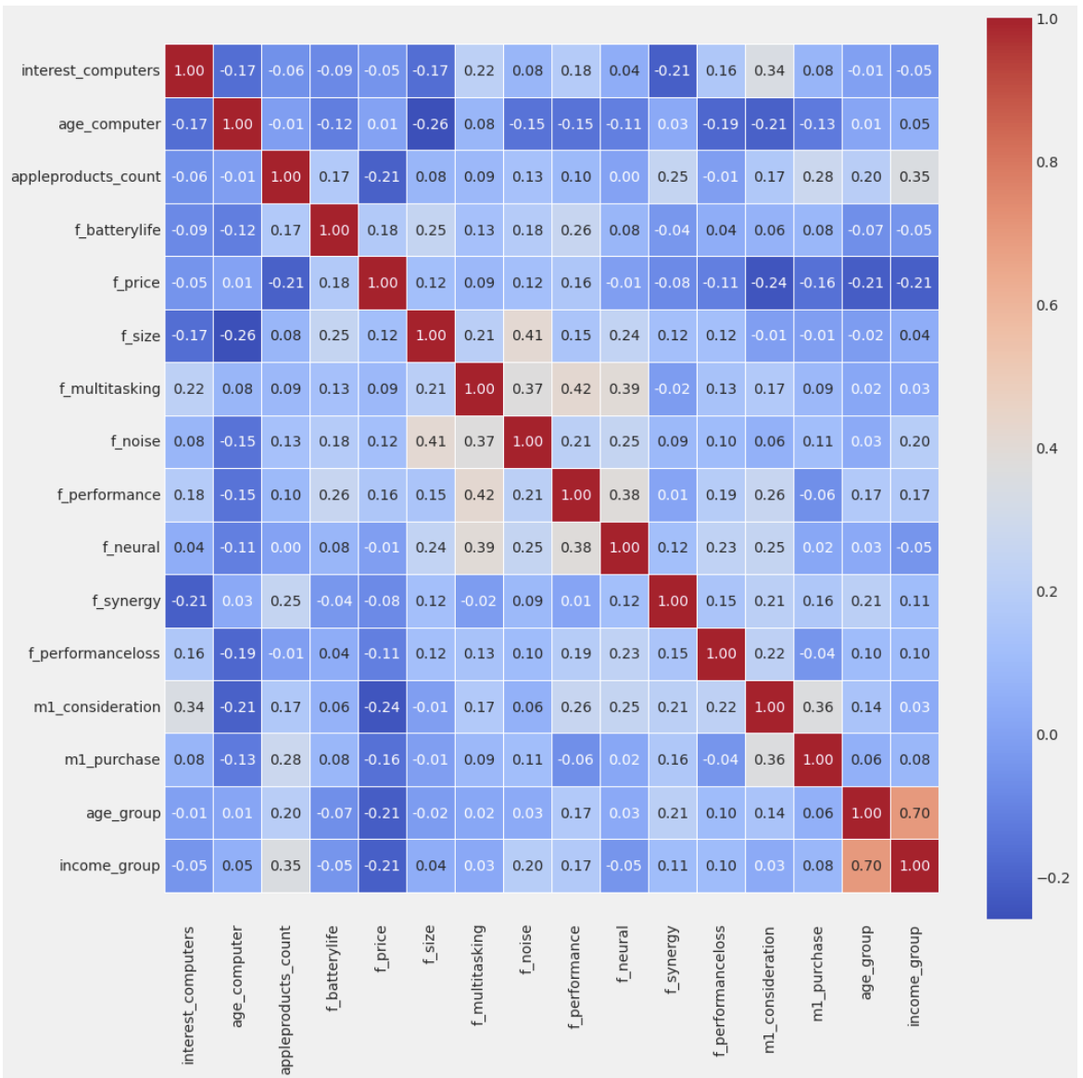
DATA ANALYSIS 06
Studying the correlations between features using Heat Map:
The purpose of this matrix is to illustrate the connections among the features. While this is valuable for feature engineering techniques, our primary concern in this lesson is the association between the target variable (identifying whether they purchased the M1 Laptop or not) and the remaining features. In essence, our attention will be primarily directed towards the last row of the matrix.
f_price, f_batterylife are amongst the features least related to the target variable while the rest features has high correlation to the target m1_purchase including m1_consideration as the strongest correlation.

Slide 16
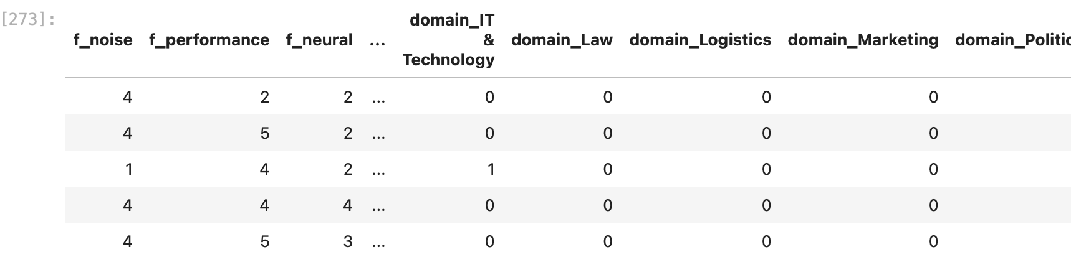
FEATURE ENGINEERING 01
We converted the categorical continuous column using the pd.get_dummies method while we also converted the ordinal categorical values using the LabelEncoder library from the sklearn.preprocessing.

Slide 17
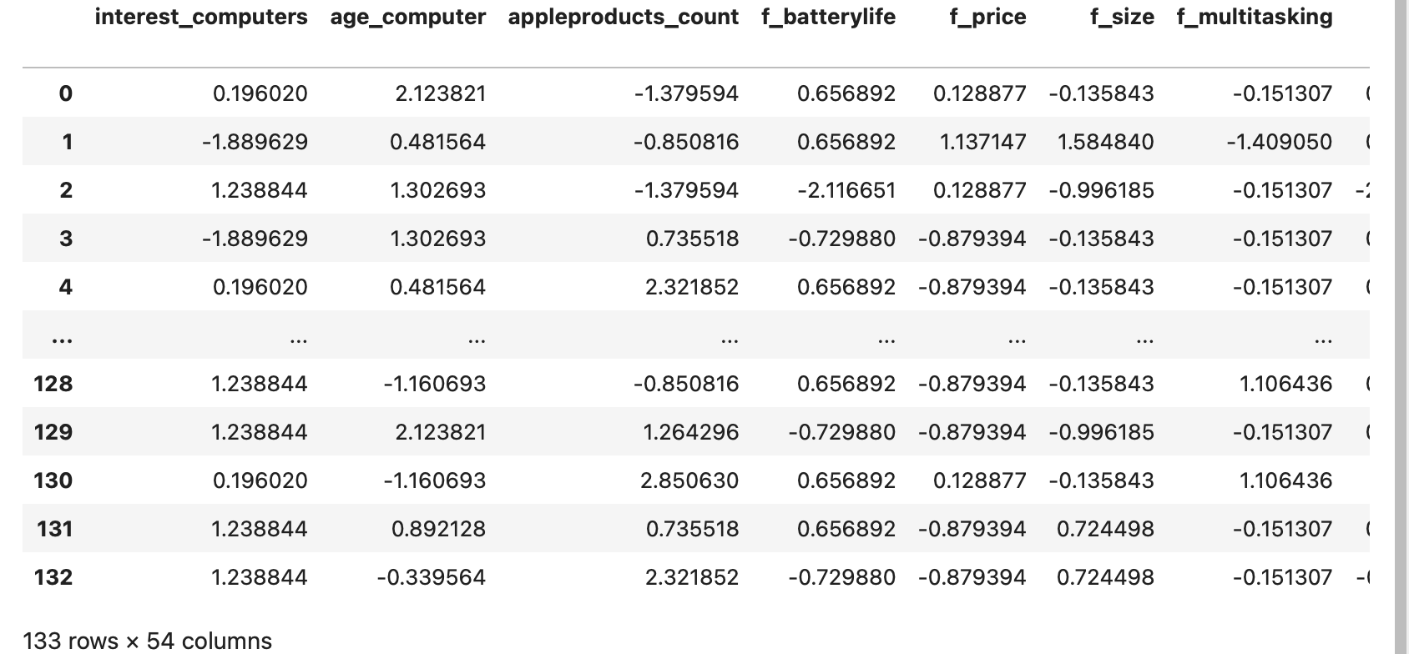
FEATURE ENGINEERING 02
Also scaled the existing numerical values in the dataset with StandardScaler so as to keep every values in the same scale for our Machine Learning Algorithm.

Slide 18
Machine Learning Analysis

Slide 19
Objective of this section
In the upcoming analysis, we'll compare five classification models (Logistic Regression, KNN, SVM, Decision Tree, and Random Forest) in predicting purchasing outcomes. To build robust models, we'll use techniques like standard scaling, cross-validation, grid search for hyperparameters, and various metrics (e.g., accuracy, precision, F1 Score). Our aim is to determine the best model for accurate predictions.

Slide 20
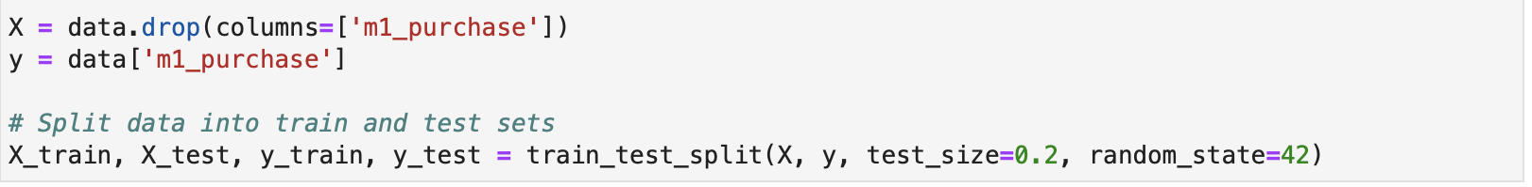
MACHINE LEARNING 01
DATA SPLITTING

Slide 21
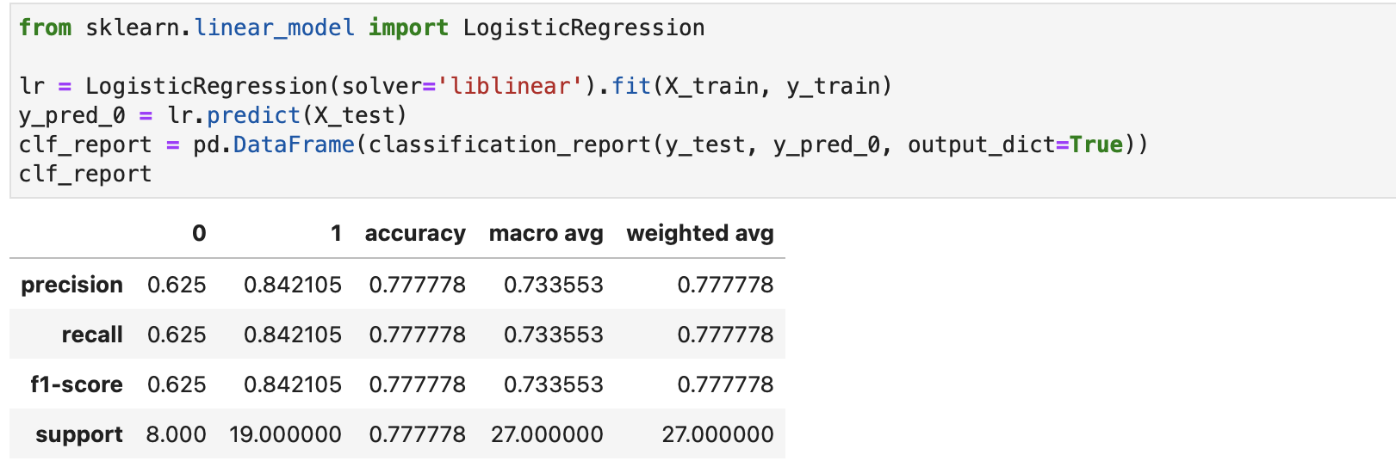
MACHINE LEARNING 02
LOGISTIC REGRESSION

Slide 22
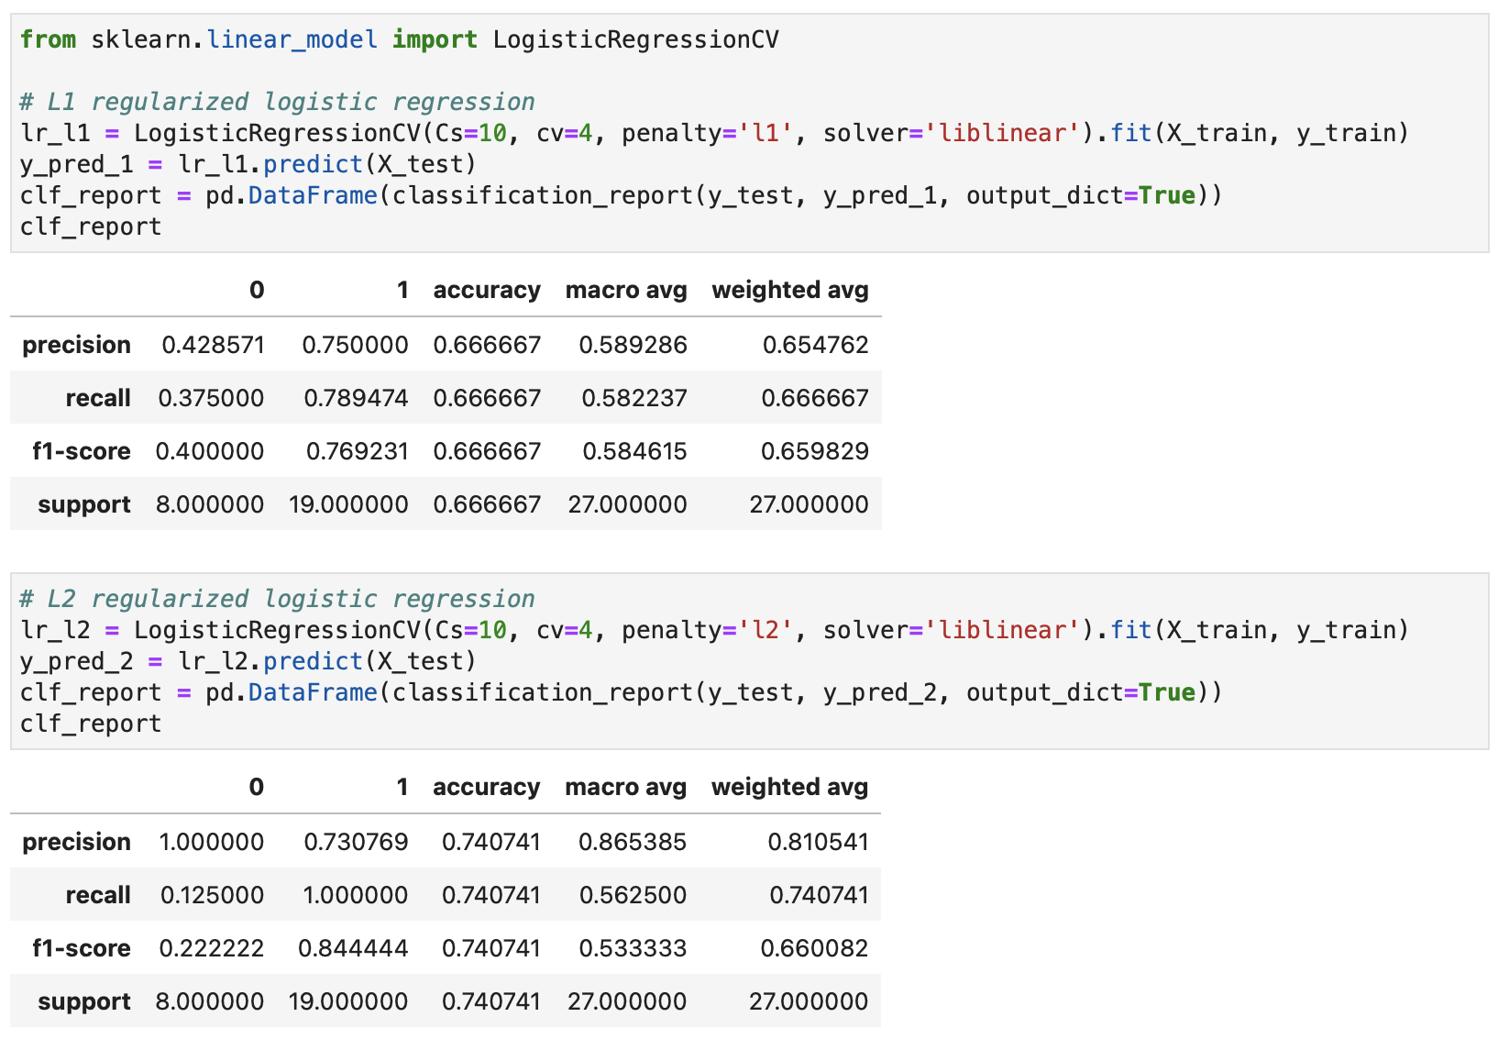
MACHINE LEARNING 03
LOGISTIC REGRESSION WITH L1 AND L2 PENALTY

Slide 23
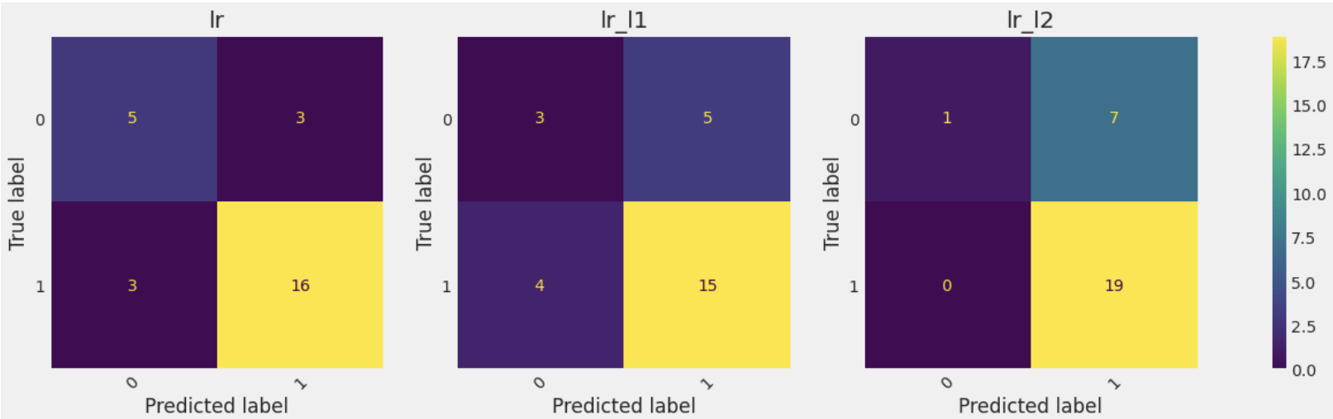
MACHINE LEARNING 04
The best model if we want to consider the Logistic Regression is the model without penalty as it comes with an accuracy of 77% while the L1 and L2 penalties contain 66%b and 74% respectively.

Slide 24
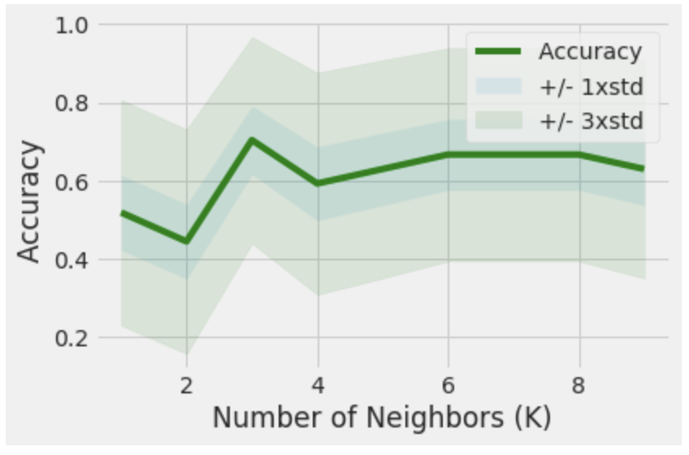
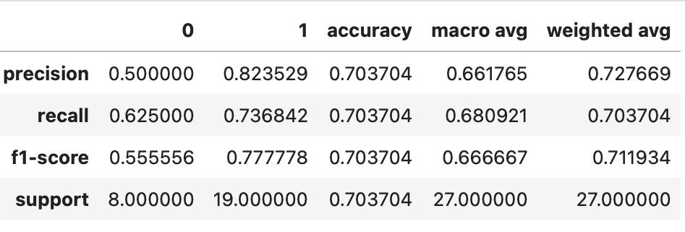
MACHINE LEARNING 05
K Nearest Neighbors

Slide 25
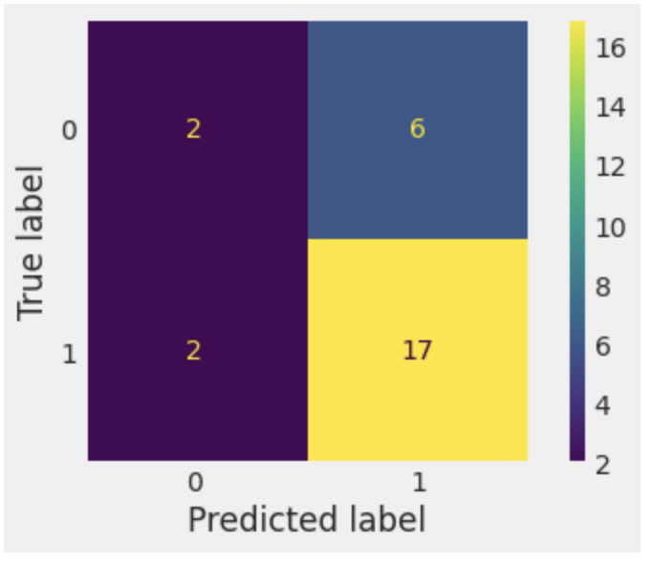
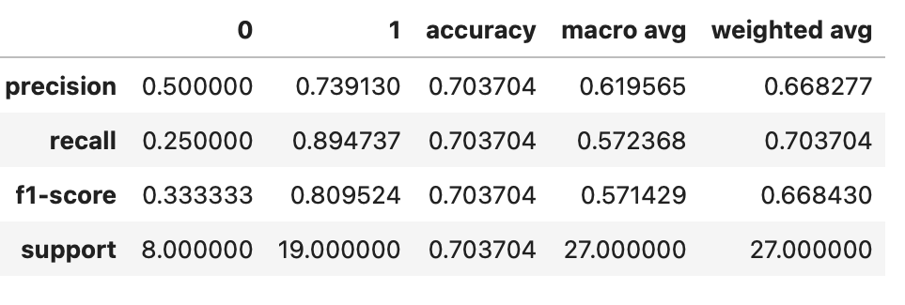
MACHINE LEARNING 06
Simple Vector Machine

Slide 26
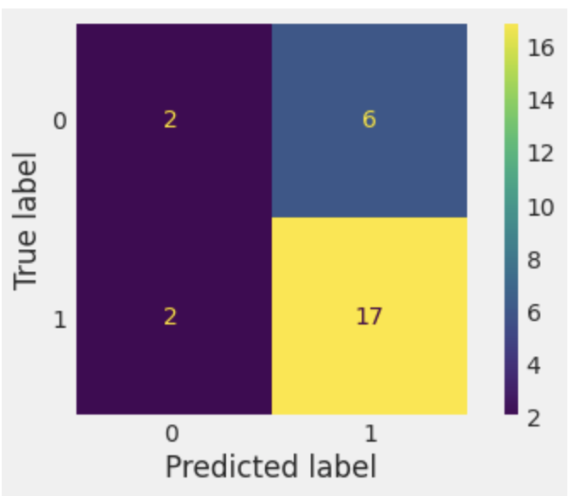
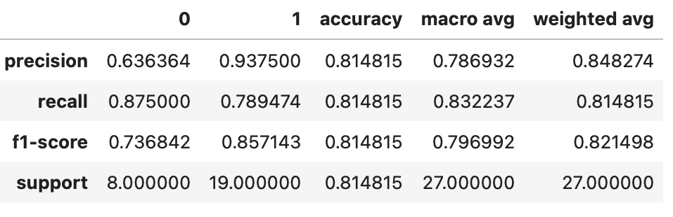
MACHINE LEARNING 07
Decision Tree

Slide 27
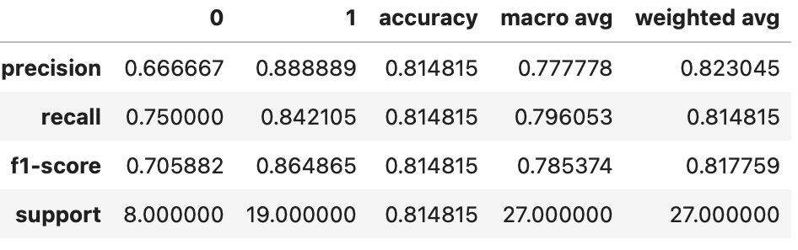
MACHINE LEARNING 08
Random Tree

Slide 28
MACHINE LEARNING O9: model comparison
As demonstrated in the previous analysis, all models yield excellent prediction results, and these results are closely aligned. However, the final model selection hinges on identifying the model with the highest performance score.
Logistic Regression: accuracy of 77%.
KNN: accuracy of 70%
SVM: accuracy of 70%
Decision Tree: accuracy of 81%
Random Forests: accuracy of 81%

Slide 29
Model Flaws and Strength

Slide 30
MACHINE ANALYSIS 10
In terms of simplicity, the Decision Tree model stands out because it provides strong predictive results while being the easiest and quickest to train due to its fewer parameters. On the contrary, models like K Nearest Neighbors (KNN) achieve optimal results with a K value of 3, but they are slower in the prediction phase because they need to calculate distances between all data points to classify each one. The Random Forest model also performs well, but its training process takes longer, mainly due to the grid search technique used to find the best parameters. This tradeoff implies that with larger datasets, these models may offer improved performance, but the training time will be longer. Ultimately, the model choice depends on your project's specific requirements, taking into account factors like dataset size, training time, and the desired level of predictive accuracy.

Slide 31


THANKS
WISDOM IZUCHUKWU ADIKE
7/09/2023

